Slide 1
Natural Language Processing & HPC
Artificial Intelligence in Life Sciences
Antonio Miranda - Text Mining Unit, BSC - antonio.miranda@bsc.es

Slide 2
0. Intro to NLP

Slide 3
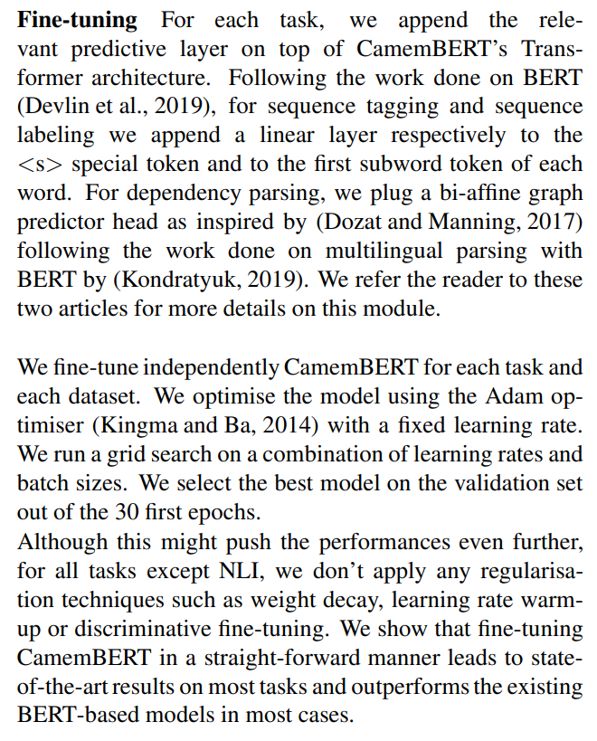
What we do in NLP
Can you read this?
Notes:
Can you read this?

Slide 4
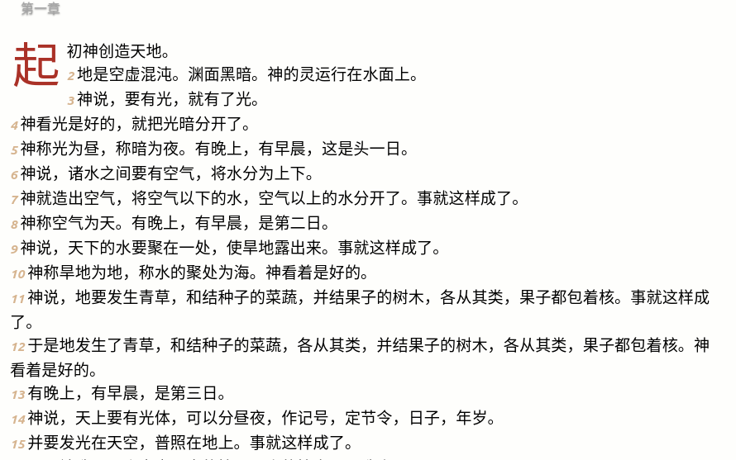
What we do in NLP
Can you read this?
https://www.wordproject.org/bibles/parallel/d/chinese.htm

Slide 5

What we do in NLP
Can you find anything here?
http://www2.humanresourcesonline.net/truth-messy-desk-gallery/

Slide 6
What we do in NLP
Notes:
Can you read this?

Slide 7
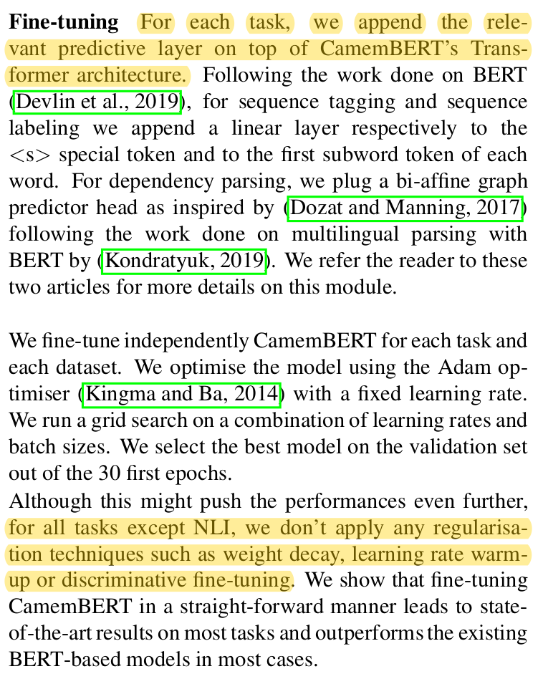
What we do in NLP
Entity extraction

Slide 8
What we do in NLP
https://www.wordproject.org/bibles/parallel/d/chinese.htm

Slide 9
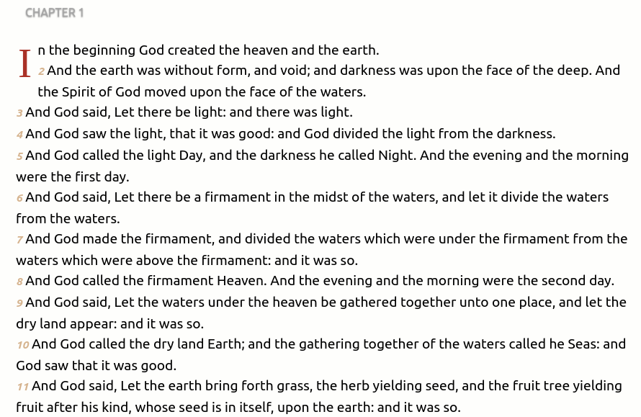
What we do in NLP
Machine translation
https://www.wordproject.org/bibles/parallel/d/chinese.htm

Slide 10
What we do in NLP
http://www2.humanresourcesonline.net/truth-messy-desk-gallery/

Slide 11

What we do in NLP
Document indexing

Slide 12
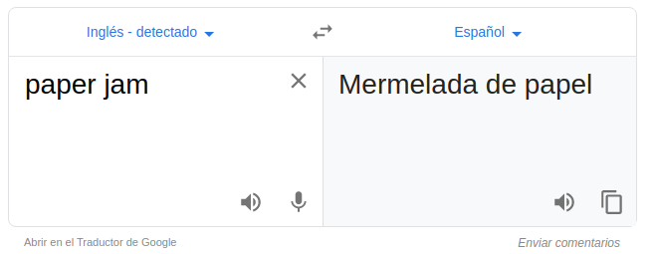
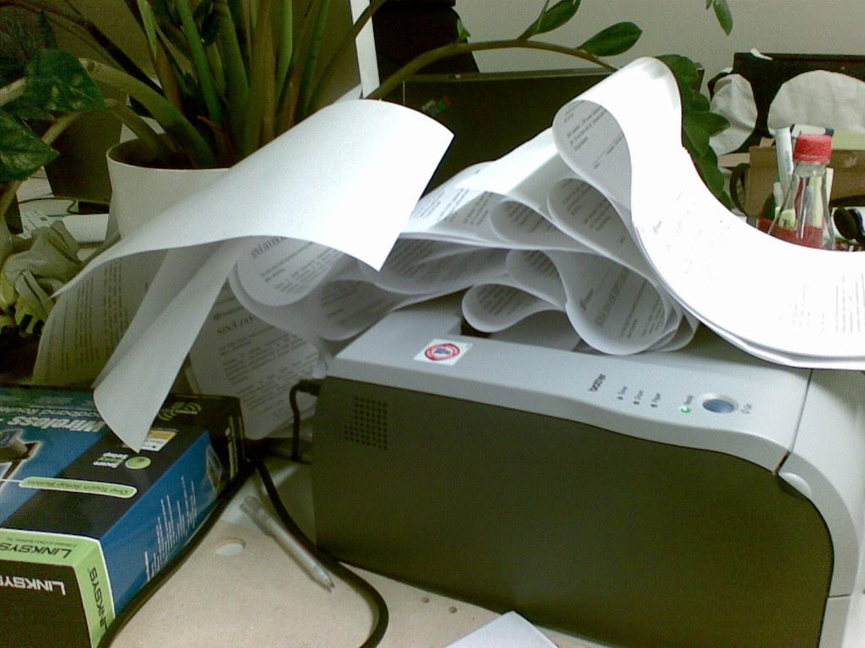
2. Why Google is not enough

Slide 13
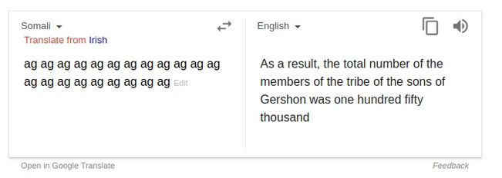
2. Why Google is not enough

Slide 14
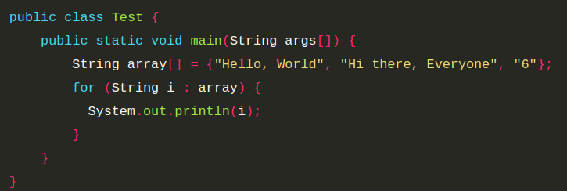
3. What NLP used to be
Example use case: is this code Python or Java?
Notes:
Which rules would you create to determine whether the code is java or python?

Slide 15
3. What NLP used to be
Example use case: is this code Python or Java?
Which rules would you create to determine whether the code is Java or Python?
Notes:
Which rules would you create to determine whether the code is java or python?

Slide 16
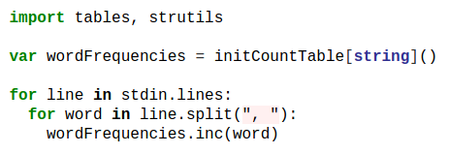
3. What NLP used to be
Characteristics:
Rule-based
Focus on pattern-matching
May have high performance in specific use cases, but often do not generalize.
Is this Nim of Python?
Can we use all the previous rules?
Notes:
Is this Nim of Python?

Slide 17
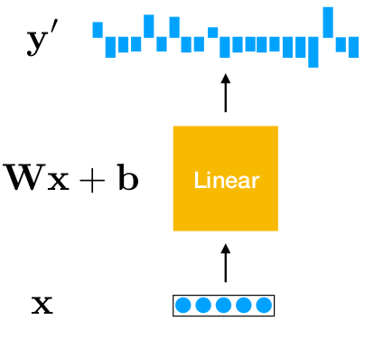
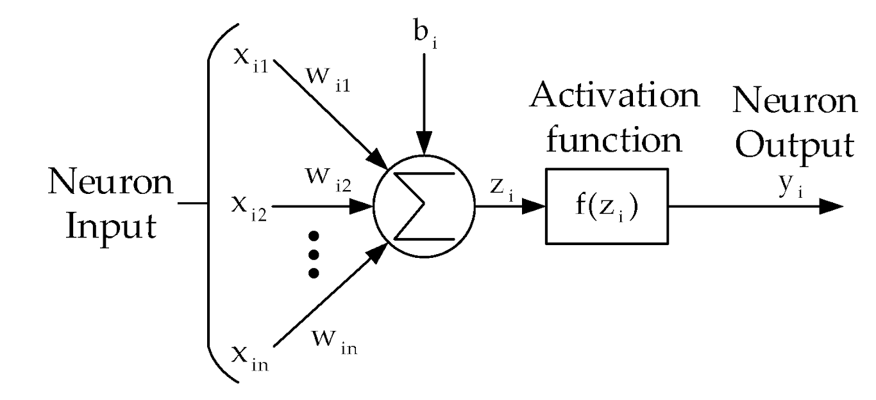
4. What NLP is today
Neural networks
activa-tion

Slide 18
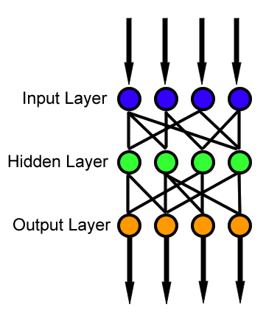
4. What NLP is today
Neural networks - FFN

Slide 19
4. What NLP is today
AI: Machine Learning and Deep Learning algorithms
Work with vectors
Need tons of data
Training may be expensive
Promise more generalization...

Slide 20
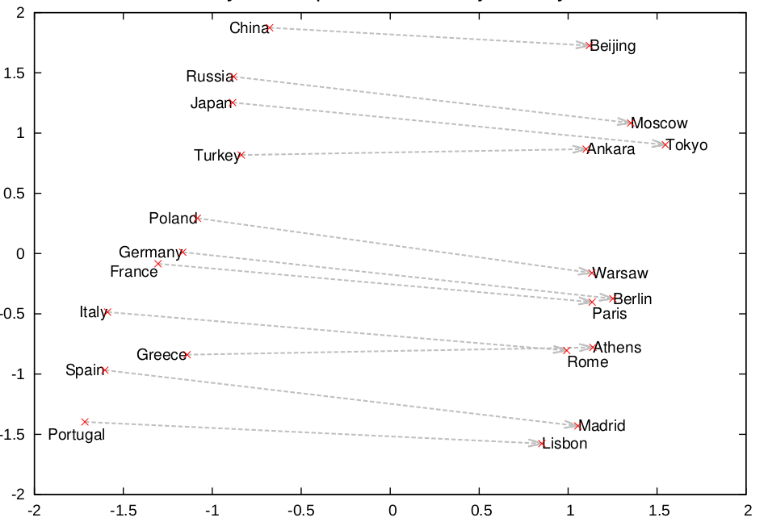
4. What NLP is today
1. Work with vectors: words are transformed into vectors through a look-up table (word embeddings)
 | X1 | X2 | ... | Xn
apple | 0.2 | 0.0 | ... | -0.3
doctor | 0.5 | -0.9 | ... | 0.11
injury | -1.5 | 0.4 | ... | -0.3
dog | -0.11 | 0.6 | ... | -0.3

Slide 21
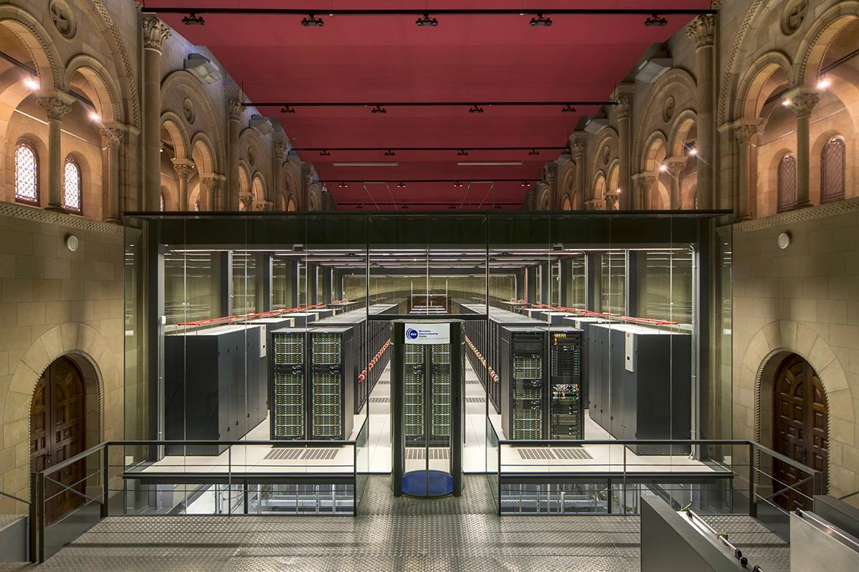


4. What NLP is today
2. Need tons of data: Need HPC
3. Training may be VERY expensive (GB of data, thousands of millions of parameters, weeks of computation): Need HPC

Slide 22

4. What NLP is today
3. Training may be VERY expensive (lots of data, thousands of millions of parameters)
Reuse models:
DeepMoji: predict emoji given the text of a tweet.
INPUT:
2 días sin salir de mi casa grabando #ROSALIA me voy a quedar loco
PREDICTION:

Slide 23
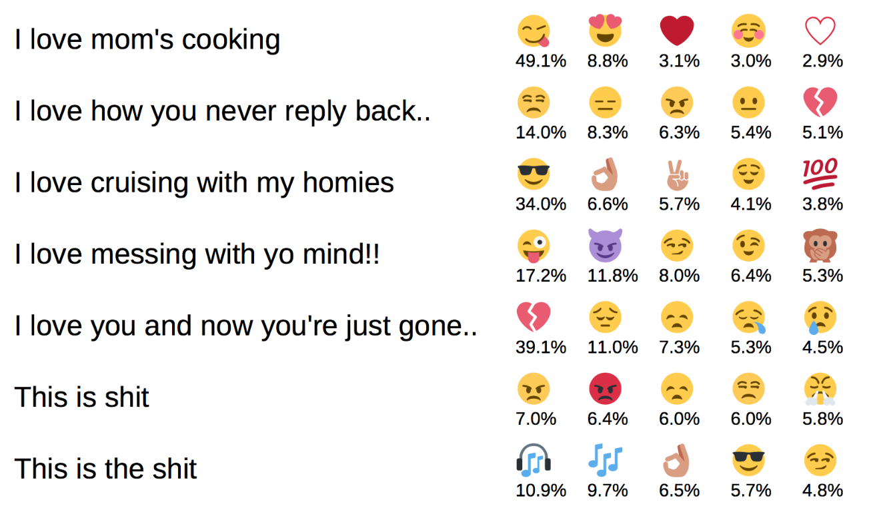
4. What NLP is today
Is the model “understanding” something deep?
Do you think we can re-use the model for anything else? Irony detection? Sentiment detection?

Slide 24
4. What NLP is today
3. Training may be VERY expensive (lots of data, thousands of millions of parameters)
Reuse models: transfer learning
Interesting idea: train the algorithm to “speak”! If it understands how to “speak”, it will understand language!

Slide 25
Introduction to language models

Slide 26
The language modeling task
Classical NLP task for learning the probability distribution of word sequences in a given language:
P(word1, word2, …, wordN)
Advantages:
Unsupervised task (tons of data available)
Well-known evaluation metrics (perplexity)
Makes sense?

Slide 27
Motivation
Direct app.:
Selecting the most probable sentence:
Speech recognition: P(no idea) >>> P (no eye deer)
Machine translation: P(tall man) >>> P(large man)
Predicting the next word:
Predictive text: P(next word | word1, word2,...)
Indirect app.: transfer learning capabilities.

Slide 28
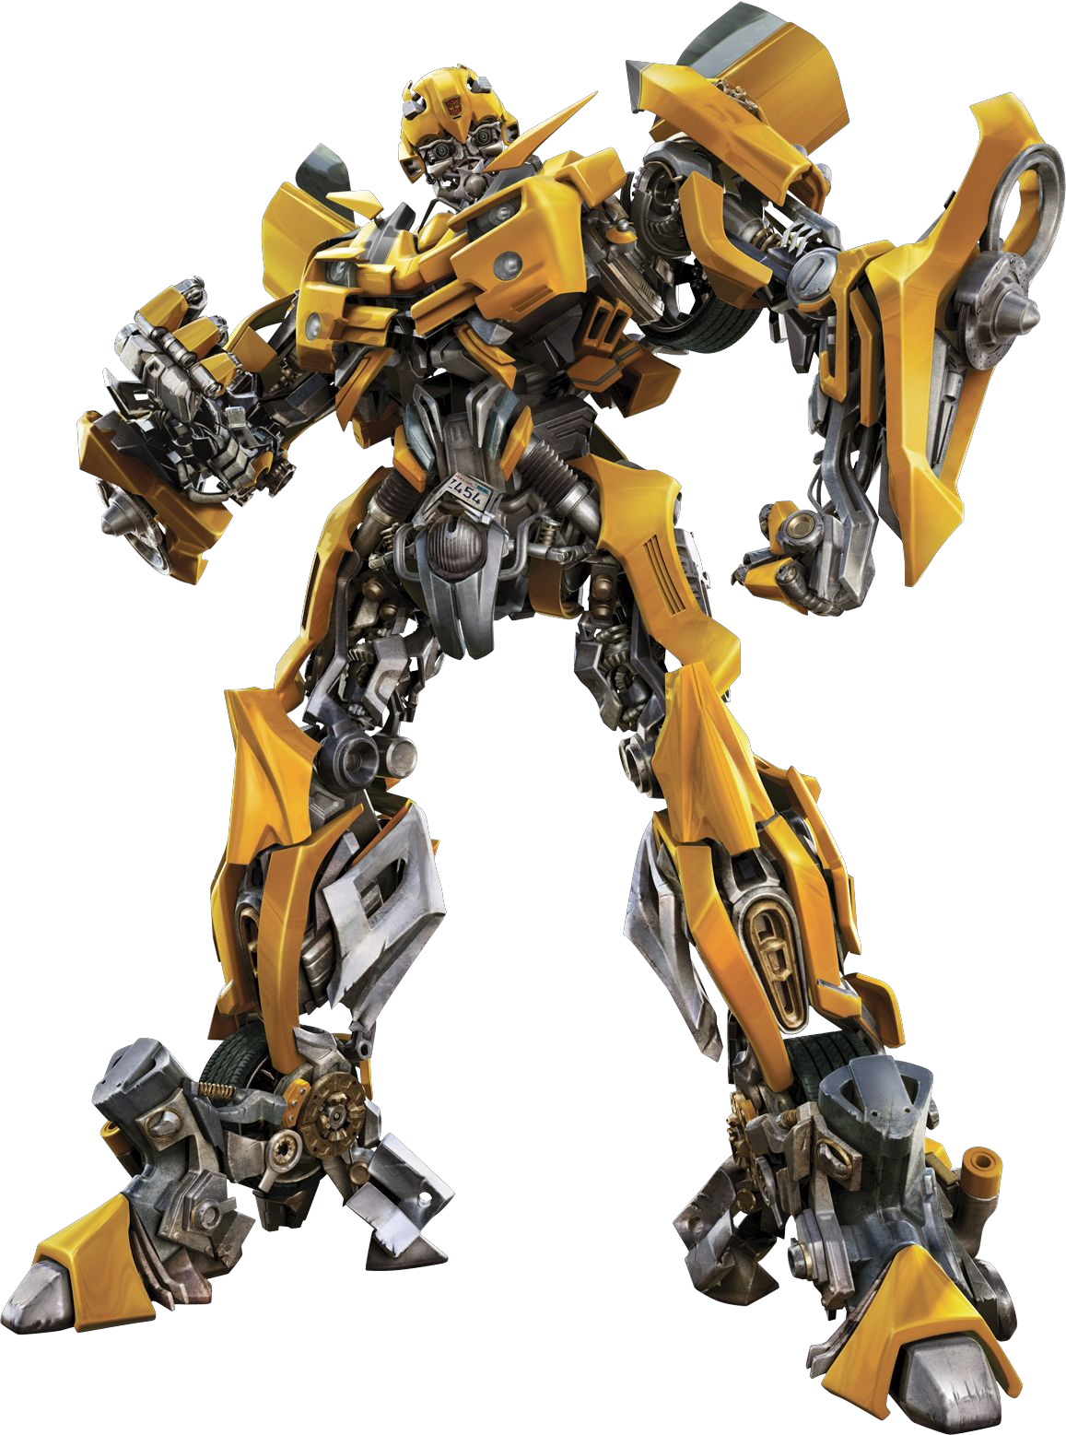
How? Language modeling architectures
Statistical language modeling
Neural language modeling:
Recurrent neural networks: LSTMs, GRUs…
Convolutional Neural Networks:
Transformers!

Slide 29
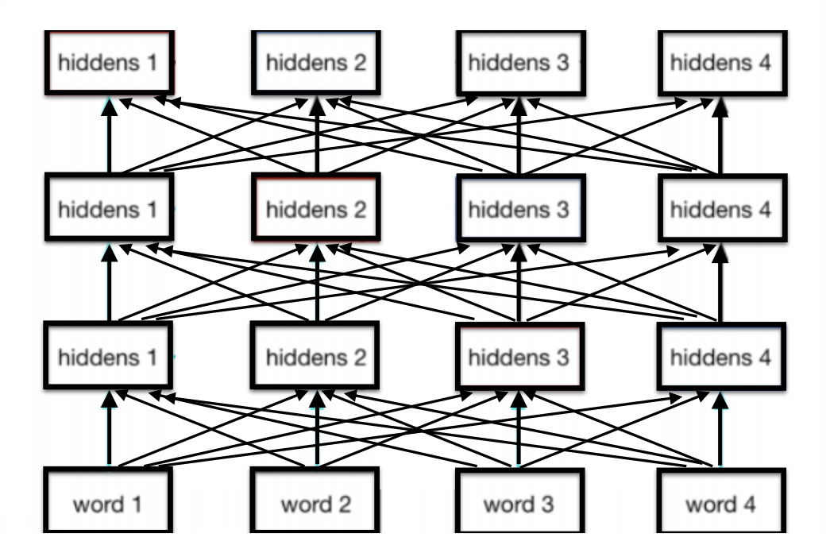
Transformer
MASSIVE FFN stacked with attention

Slide 30
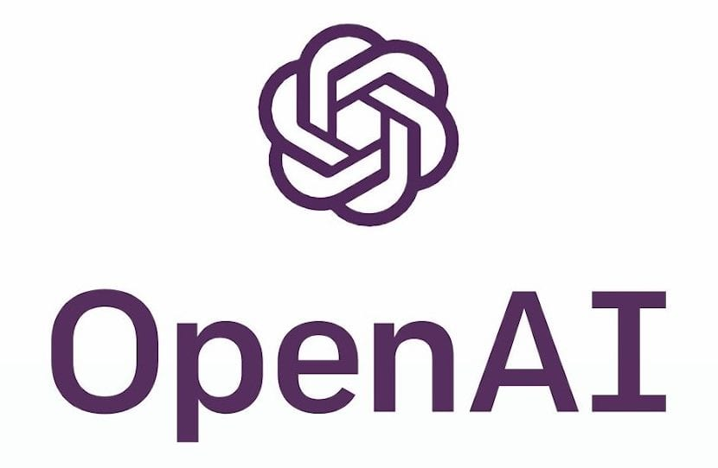

GPT-2 (2019)
Parameters: 1.5 Billion (linear regression has 2...)
Training:
8 million web pages
Predict each token given the previous ones. Example: “The dog is playing.”
Input: “The” -> Predict: “dog”.
Input: “The dog” -> Predict “is”.
Input: “The dog is” -> Predict “playing”.
The same for very large paragraphs (long-range dependencies!)

Slide 31
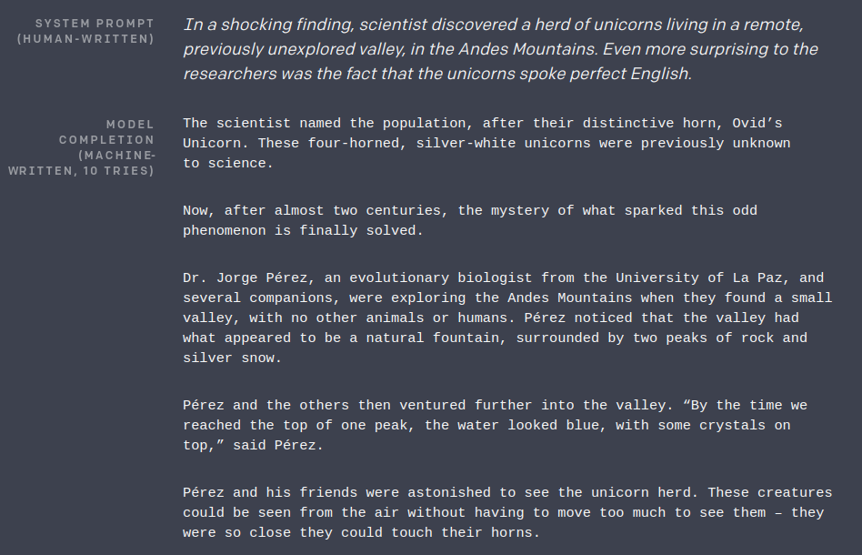

Slide 32
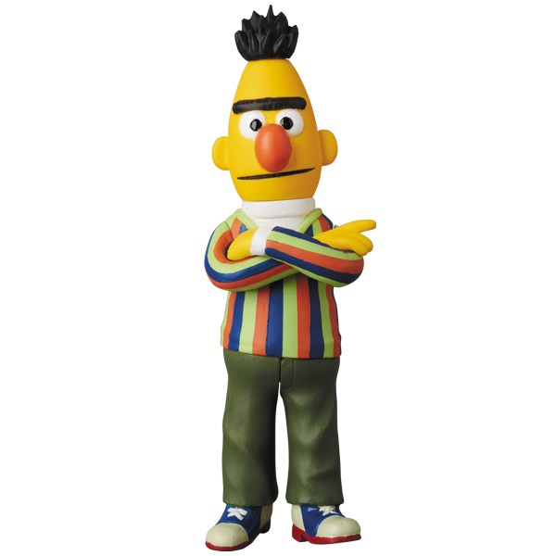
BERT (2018)
Parameters: 340M
Training:
ALL Wikipedia and a book corpus: 3.3B words.
Task 1: Predicting randomly masked tokens:
Input: “The [MASK] is playing” -> Predict: “The dog is playing”
Input: “[MASK] dog [MASK] playing” -> Predict: “The dog is playing”
Task 2: Next sentence prediction (binary classification)

Slide 33
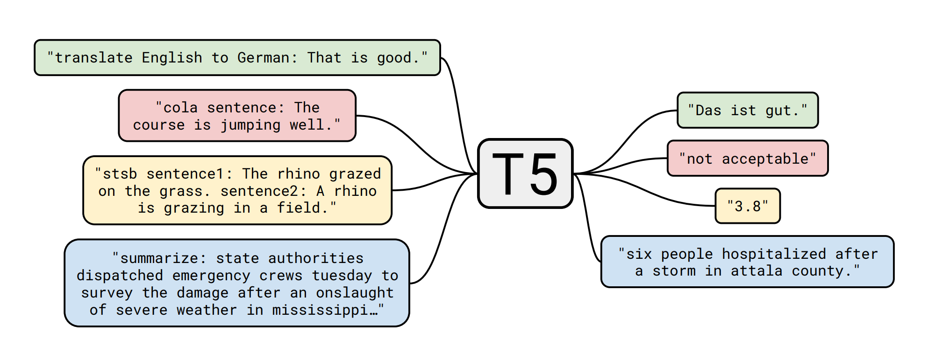
T5 (2019)

Slide 34
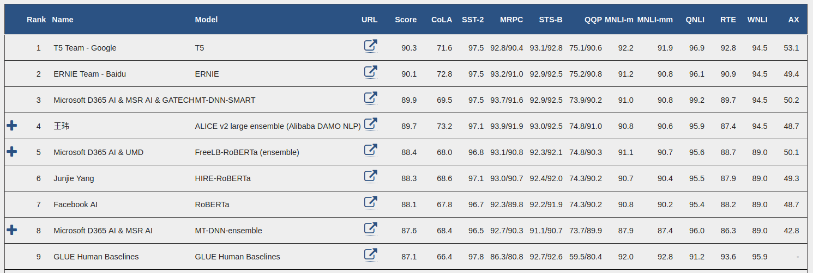
Transformer language models
Realization 1: The algorithms from language modeling task can be applied to several NLP tasks:

Slide 35
Transformer language models
Realization 1: The algorithms from language modeling task can be applied to several NLP tasks:

Slide 36
Transformer language models
Realization 2: More data + bigger model = better results.
GPT2 >> GPT: 10x more data and parameters.
BERT Large >> BERT Base: 3x more parameters
T5 is the best of all of them: C O L O S S A L model: 11 BILLION parameters
“it is often possible to achieve better performance simply by training a larger model on a larger dataset”
Google team

Slide 37
The Transformer Space Race (2018-?)
Extreme competition between big AI players for building large Transformer language models. Massive models. Massive as in M A S S I V E.
Models:
Based on BERT:
Generic improvements:
RoBERTa for “Robustly Optimized BERT approach”
DilBERT
...
Language specific improvements:
CamemBERT
...
UMLFiT: Universal Language Model Fine-tuning for Text Classification
...

Slide 38
To sum up: Contextual embeddings
Vanilla word embeddings do not take into account the context.
Contextual embeddings (transformer models) do (obviously :) )
“Language models are the new embeddings”

Slide 39
2. How to use transformer models?

Slide 40
Using Transformer language models
Train from scratch
Transfer learning
Options

Slide 41
Train from scratch
Pick up a given architecture (eg. BERT)
Alternatively, modify the architecture (very hot research area)
Preprocess your data:
Cleaning
Recommended to split words into subwords
Fit the model with your data.
Profit!

Slide 42
Train from scratch
We are building a resource other people can benefit from!
But:
Computationally expensive
The corpus should be huge

Slide 43
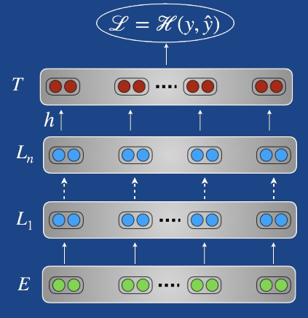
Transfer learning
Pick up a pre-trained model (eg. BERT already trained by Google)
2. Preprocess your data...
3. Use it with your small data! Options:
Weight freezing: Add your own layers on the top!
Fine tuning with your data + add your own layers!
Zero shot?
Classification layer
BERT

Slide 44
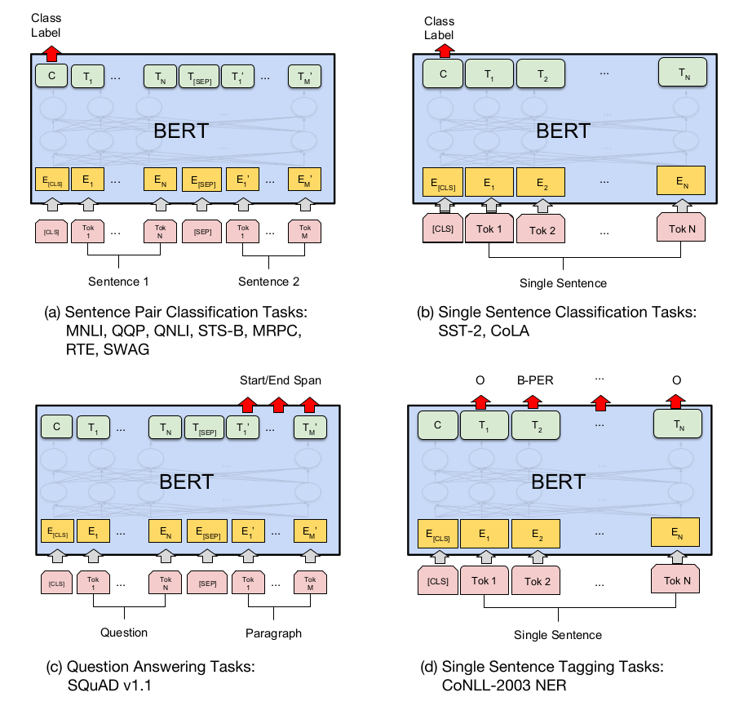
How to do transfer learning? BERT example
Notes:
Given a question and a passage from Wikipedia containing the answer, the task is to predict the answer text span in the passage.
As shown in Figure 1, in the question answering task, we represent the input question and passage as a single packed sequence, with the question using the A embedding and the passage using the B embedding. We only introduce a start vector S ∈ R H and an end vector E ∈ R H during fine-tuning. The probability of word i being the start of the answer span is computed as a dot product between T i and S followed by a softmax over S·Ti all of the words in the paragraph

Slide 45
Recommended libraries
Facebook’s Fairseq
Huggingface’s 🤗 Transformers
FastAI/UMLFiT

Slide 46
3. Future work at BSC?

Slide 47
Low-hanging fruit?
Steps to get published:
Pick an NLP task of your choice
Apply transfer learning from BERT
Easily improve SOTA
Profit!
But:
Is it that easy?
What is our competitive advantage?

Slide 48
Why is BSC the right place to do more?
High Performance Computing
Data
Mission to build resources for other researchers or institutions

Slide 49

Possible ideas
Build a Spanish (Catalan, Basque…?) language model
Build a domain-specific language model (medical/bio)
Investigate approaches for domain adaptation for language models
Conduct research to improve compute and data efficiency

Slide 50
5. Why is this presentation subtitled “Artificial Intelligence in Life Sciences”?

Slide 51
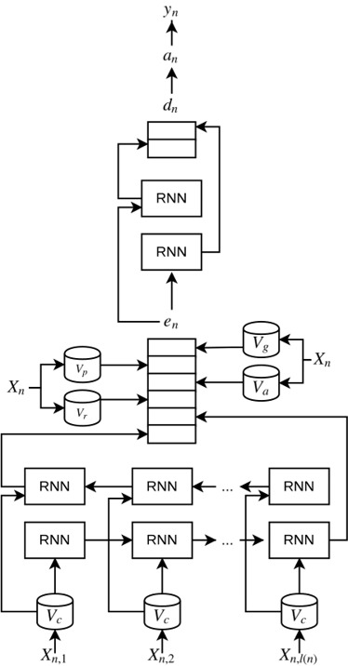
At TeMU we do...
1. Clinical word embeddings (github.com/PlanTL-SANIDAD/Embeddings)
2. Clinical entity extractors: PharmaCoNER Tagger (http://temu.bsc.es/pharmaconer/)

Slide 52
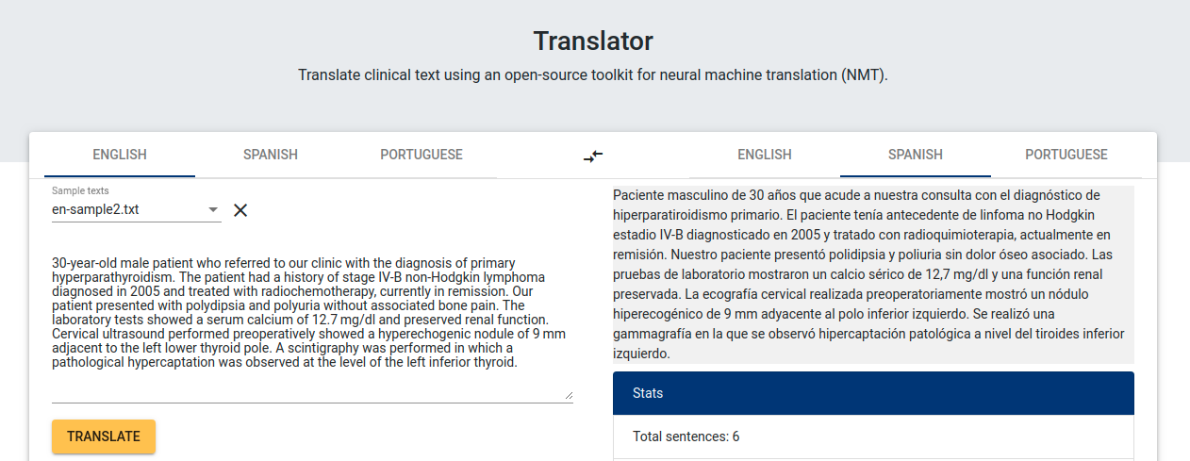
At TeMU we do...
3. Medical Translator

Slide 53
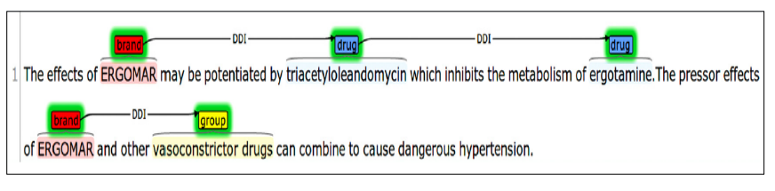
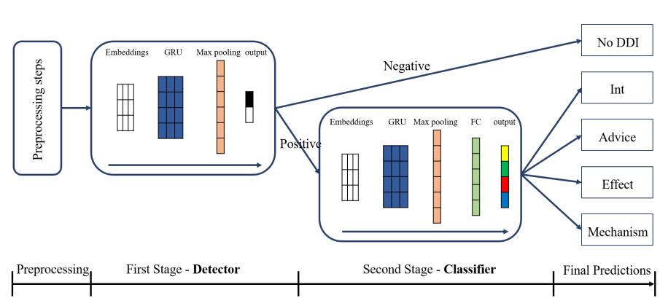
At TeMU we do...
4. Drug-drug interactions detector

Slide 54

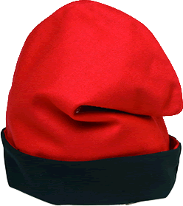



At TeMU we do...
5. ONGOING: Clinical BERT, Catalan BERT...
6. And many more! Ictusnet, meddocan, codiesp...
Ictusnet | Ictus report information extraction
Meddocan | Clinical text anonymization | http://temu.bsc.es/meddocan/
Codiesp | Clinical text indexing | http://temu.bsc.es/codiesp/

Slide 55
http://temu.bsc.es/
antonio.miranda@bsc.es
Thanks to:
Jordi Armengol (jordi.armengol@bsc.es)

